Slide 1
QUERY CLASSIFIER
Updated May 2025

Slide 2
Project Name : Query Classification System
College / University Name : Vellore Institute of Technology
Project Participants: Harshit Gaur
Kriya Gadag
Meghna Varma
Nikita Jain
Vishnu Adithya
Mentor Names : Saikat Mukherjee
Sharath Sivamalaisamy
Project Code link /GIT Hub: https://github.com/meghnavarma25/HPE_queryClassifier_Final.git
Note: Please show this slide briefly at the beginning of your recorded demo so people scanning the recordings can find this easily

Slide 3
PROBLEM STATEMENT
Modern enterprises possess vast, complex datasets spanning finance, operations, supply chain, and customer analytics.
Natural language queries to retrieve data vary in complexity—from straightforward factual lookups to nuanced analytical requests involving reasoning or multi-faceted goals.
Therefore, there is increased need for a Query Classification system that enables effective interpretation and downstream processing of such queries.
Retrieval-Augmented Generation (RAG) addresses this by combining intelligent document retrieval with language generation to interpret complex, natural language questions, break them down when needed, and generate accurate, context-aware responses.

Slide 4
OVERVIEW OF DATASET
Created own dataset from HPE’s quarterly press releases of year 2023 and 2024, containing the query and its category
Total queries: 583 ( around 115 queries of each category)
The categories are: Factual, Aggregate / Time Based, Global Sensing, Reasoning / Inference, Multi-part
Data Augmentation : generated additional paraphrased versions of queries using a language model, preserving the original intent but increasing linguistic diversity. This helps the model generalize better to real-world phrasing variations

Slide 5
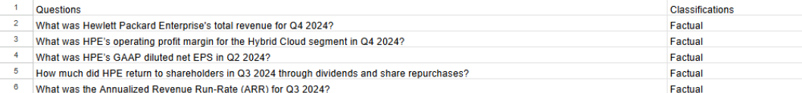
OVERVIEW OF DATASET
Schema of the dataset:
The dataset was randomly split into training and test sets in an 80:20 ratio using stratified sampling to ensure class distribution was preserved, enabling effective model training and unbiased performance evaluation. (111 queries for testing)

Slide 6
QUERY CLASSIFICATION MODELS 1.ROBERTA
RoBERTa is a transformer model trained with techniques like dynamic masking and no next-sentence prediction. It excels at understanding natural language, making it ideal for identifying query intent in HPE queries.
Fine-Tuning Steps:
1. Initialize Pretrained RoBERTa – Leverage its language understanding.
2. Add Classification Head – A layer for query type prediction.The classification layer is a fully connected (dense) neural network layer added on top of the RoBERTa model to map its output to task-specific predictions.
3. Train on Labeled Data – Fine-tune using annotated HPE queries.
4. Configure Parameters – Use Binary Cross-Entropy Loss for classification.
5. Validate the Model – Evaluate on a test set to ensure generalization.
Outcome: The model accurately classifies whether a query belongs to the target category.

Slide 7
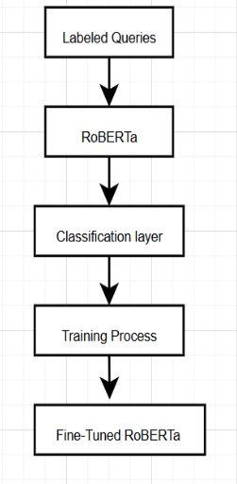
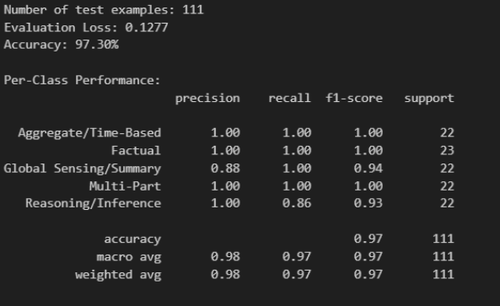
EVALUATION METRICS: PROCESS

Slide 8
2. ENSEMBLE MODEL
How it works:
Uses SpaCy to extract 18 key features (WH-words, verbs, ARR, EPS, Q1, FY24, etc.)
Features fed into an ensemble of Logistic Regression, Random Forest, and SVM
Hyperparameter-tuned for optimal performance
Results:
82% accuracy on single-label queries
97% accuracy on multi-class queries
Fast on CPU’s, resource efficient model

Slide 9
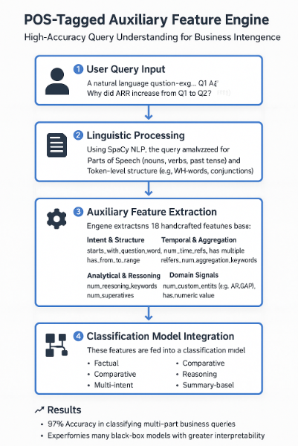
ENSEMBLE MODEL
Feature Engineering
POS Tags: Capture nouns, verbs, and tenses for grammatical cues Heuristics: Detect signals like time, reasoning, comparisons, and multi-intents
Entity & Keyword Recognition: Identify domain terms (e.g., ARR, EPS, GAAP)
Query Type Signals: Classify intent as factual, comparative, reasoning, or multi-part
Complements transformer embeddings with interpretable, intent-aware features
Models Used
Logistic Regression: Fast, interpretable; supports multiclass via one-vs-rest
SVM: Effective in high-dimensional, non-linear spaces using kernels
Random Forest: Robust ensemble capturing complex feature interactions

Slide 10
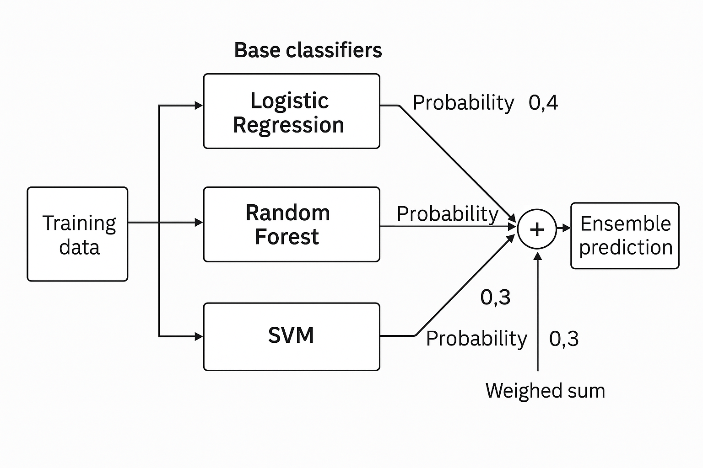
ARCHITECTURE

Slide 11
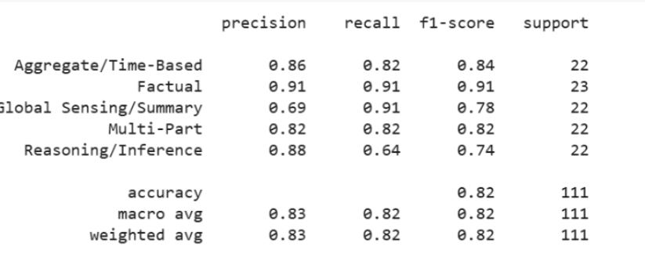
EVALUATION METRICS
Each model was trained using GridSearchCV to optimize hyperparameters
Combined all three models into an ensemble for improved performance
The ensemble leverages: Logistic Regression's simplicity, SVM’s precision, Random Forest’s robustness
Designed to enhance accuracy and generalization on multiclass classification tasks

Slide 12
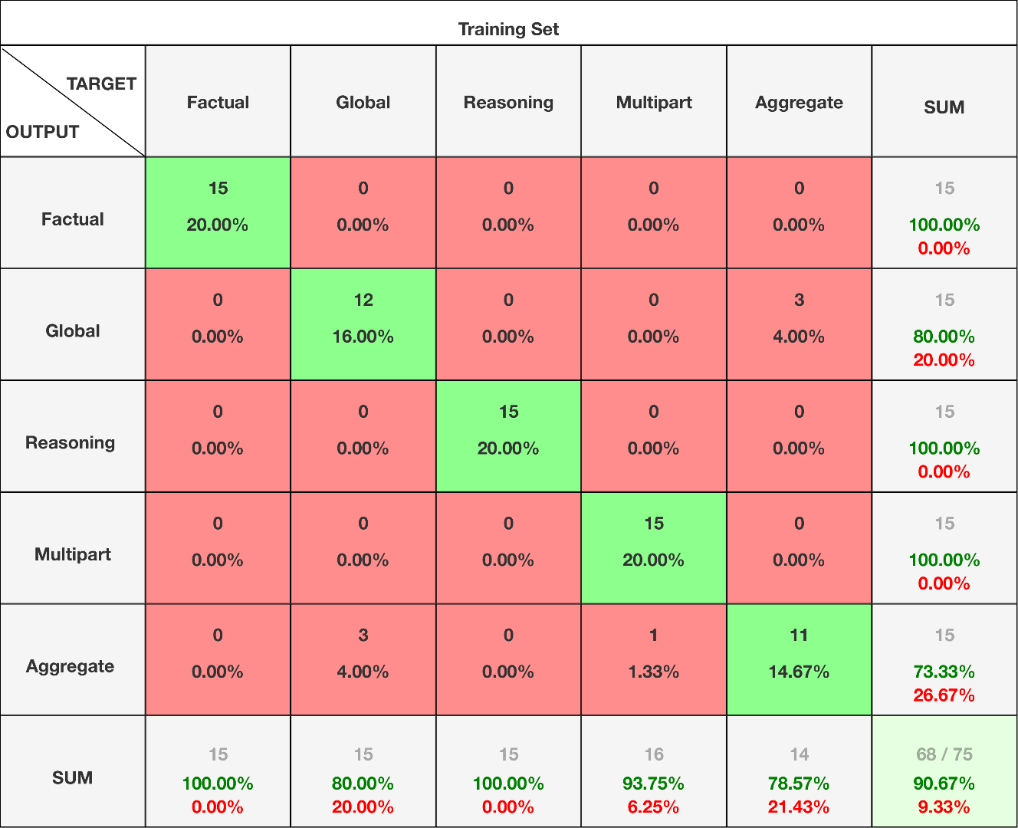
3. GPT MODEL
Explored Multiple Prompting Techniques:
Keyword-Based Prompt.
Probability-Driven Prompt.
Comprehensive Prompt Structure:
Relevant keywords
Example queries for context
Detailed category descriptions
A model preference system
Models Evaluated: GPT-4o-mini, GPT-4o, Phi-4, DeepSeek-R1, Codestral-2501,Mistral,Gemini
WHY GPT-4o :
Outperformed in Multiple Valid Outputs .
Better context understanding and comparison.
Key Insight: GPT-4o demonstrated an ability to select the most accurate classification among competing outputs, reflecting stronger internal weighting and preference logic when ambiguity was present.

Slide 13
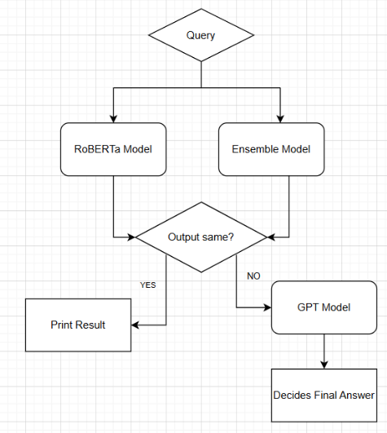
PIPELINE USED
The system starts with a user-submitted question or query that needs classification or response generation.
The query is processed simultaneously by:
RoBERTa Model – a transformer model fine-tuned for classification tasks.
Ensemble Model – a mix of models (e.g., Random Forest, SVM, etc.) that combine predictions for robust output.
Working:
If both models agree: The system is confident and prints the result directly.
If they disagree: The query along with the results of both the models is escalated to the GPT model.

Slide 14
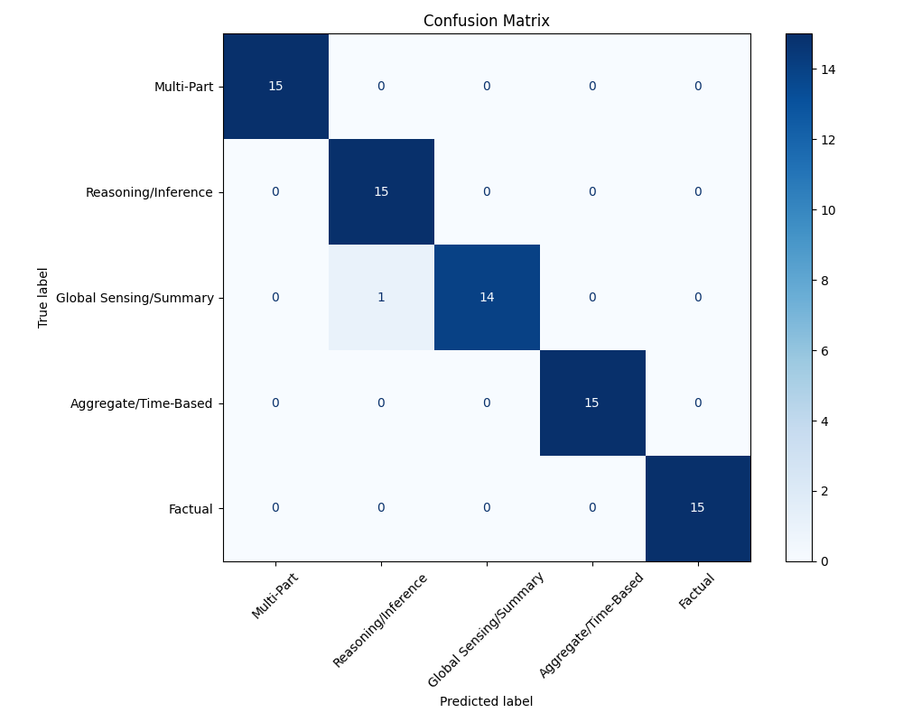
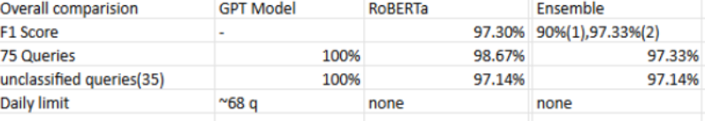
COMPARISON OF MODELS
RoBERTa offers high accuracy (97.30%) and fast, resource-efficient classification with no usage limits, making it ideal as the first-pass model in the pipeline.
The Ensemble is used to combine outputs from multiple algorithms, giving it better generalization and higher confidence in edge cases.
GPT is used only when RoBERTa and Ensemble disagree, leveraging its 100% accuracy on test queries and unclassified data.

Slide 15
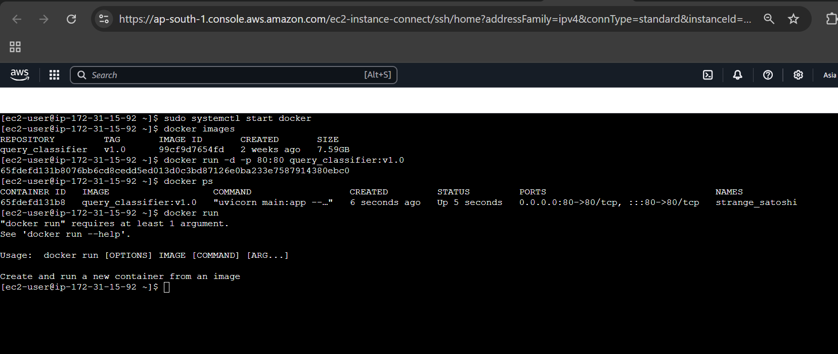

DEPLOYMENT & INTEGRATION
Backend:
Dockerized the application within EC2 by writing a custom Dockerfile and building the image.
The application is publicly accessible through the EC2 instance's public IP.

Slide 16
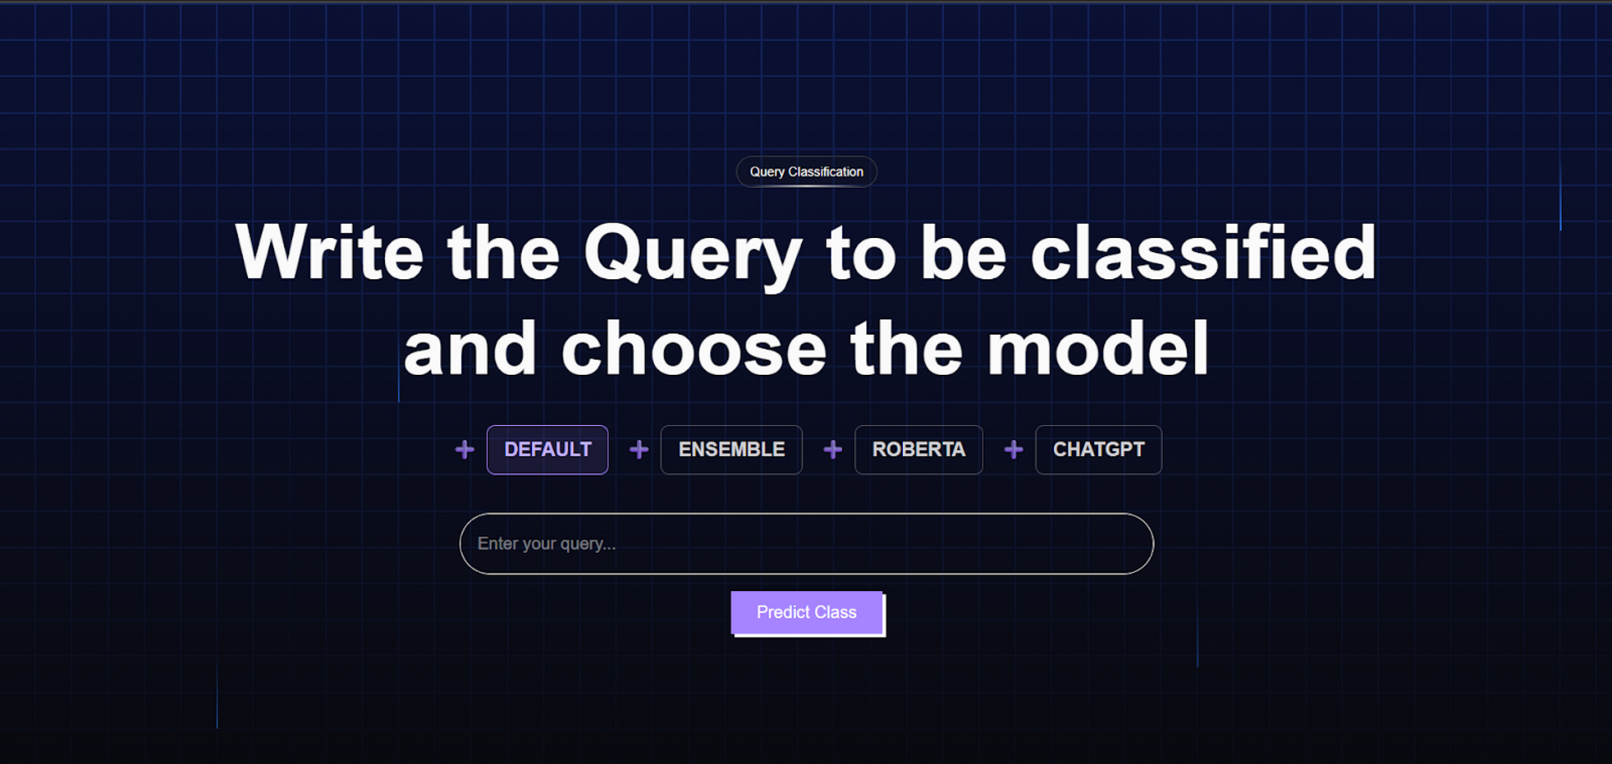
DEPLOYMENT & INTEGRATION
Frontend:
Deployed next frontend to vercel
Implemented a custom App Router within the Vercel-hosted frontend (Next.js) to act as a proxy, securely forwarding HTTPS requests from Vercel to the backend server hosted on an EC2 instance.
Helps to effectively bypass mixed-content and CORS issues.

Slide 17
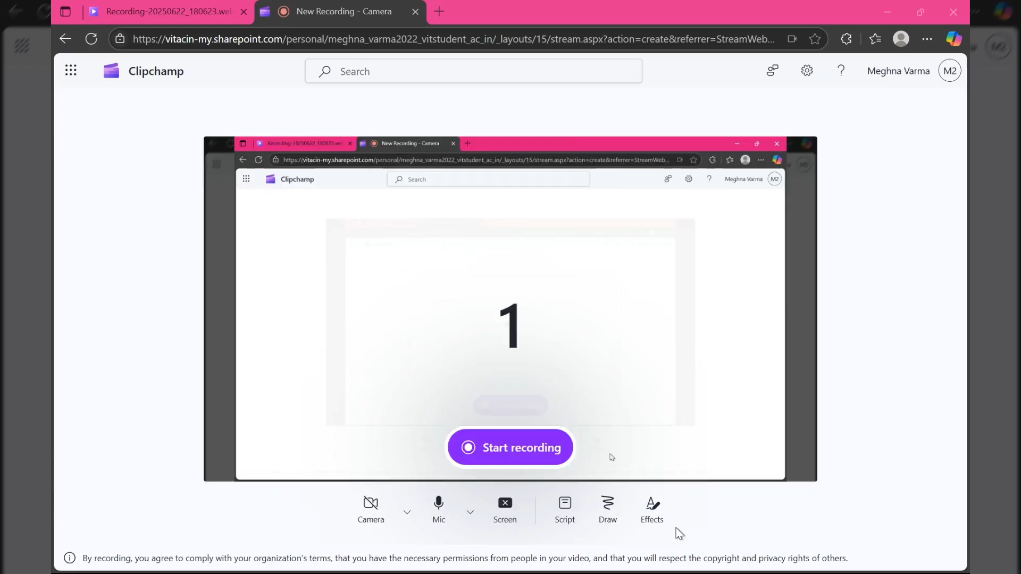
DEMO VIDEO

Slide 18
KEY LEARNINGS
Learned how to collect or synthesize a dataset of realistic enterprise queries.
Understood the complexities of manual labeling, including inter-annotator agreement and balancing class distribution.
Explored different techniques for text classification like:
Traditional ML models
Transformer based models
LLMs both locally hosted and accessed via API keys.
Understood how to interpret model errors and refine training strategies
Understood how to build an inference-ready REST API for real-time query classification

Slide 19
CONCLUSION
Developed a scalable query classification system using modern web technologies.
FastAPI backend provides fast and reliable API endpoints for classification tasks.Explored different techniques for text classification like:
Docker containerization ensures consistent and portable deployment.
Backend hosted on AWS EC2 for flexible and cheap cloud infrastructure.
Frontend built with Next.js and deployed on Vercel for a responsive and performant user interface.
Achieved seamless integration between frontend and backend for smooth user experience.
The project highlights an effective combination of cloud, containerization, and modern frameworks to build a maintainable and efficient system.

